Slide 1

UNIVERSITY INSTITUTE OF SCIENCES
Academic Unit V
Bachelor of Engineering
(Computer Science & Engineering)
Biology For Engineers
Biosensors, principle and its types
DISCOVER . LEARN . EMPOWER

Slide 2
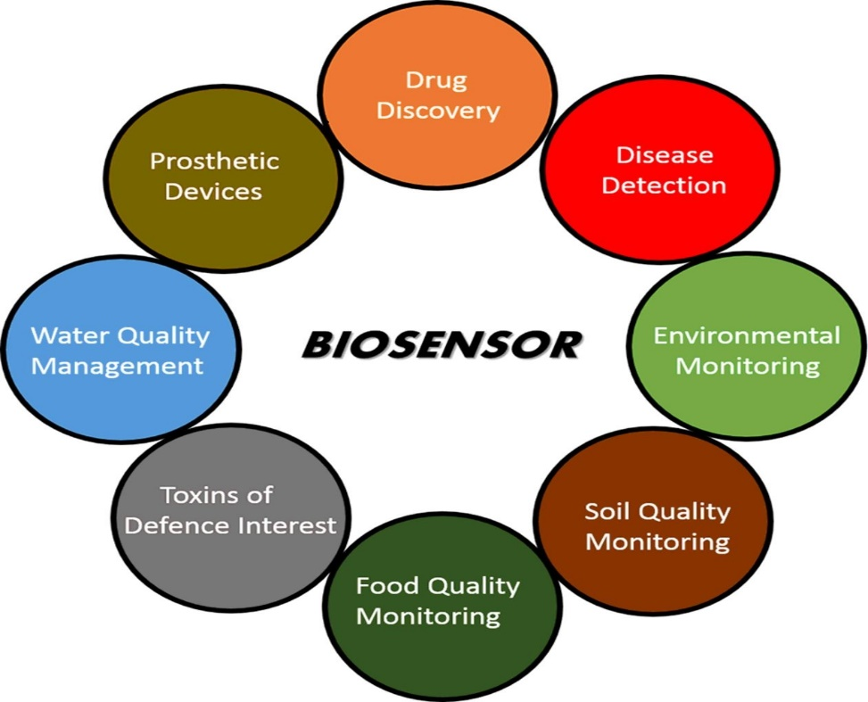

Course Outcome
CO Number | Title | Level
CO1 | Identify the biological concepts from an engineering perspective. | Remember
CO2 | Development of artificial systems mimicking human action. | Understand
CO3 | Explain the basic of genetics that helps to identify and formulate problems | Understand
CO4 | Apply knowledge of measurement system, biomedical recording system and biosensors to excel in areas such as entrepreneurship, medicine, government, and education. | Understand
CO5 | Integrate biological principles for developing next generation technologies
Will be covered in this lecture
https://images.app.goo.gl/5obqqxo93P2UBmdU6

Slide 3
SYLLABUS
Unit-2 | Biosensors and measurement system | Contact Hours: 15
Chapter 1 Medical Instrumentation Chapter 2 Measurement System Chapter 3 Biological Sensor | Medical Instrumentation: Sources of biomedical Signals, Basic medical Instrumentation system, Performance requirements of medical Instrumentation System, Microprocessors in Medical instruments, PC base medical Instruments, General constraints in the design of medical Instrumentation system, Regulation of Medical Devices. Measurement System: Specification of instruments, Statics & Dynamic characteristics of medical instruments, Classification of errors. Statistical analysis, Reliability, Accuracy, Fidelity, Speed of responses, Linearization of technique, and Data Acquisition System. Biological sensors: Sensors/ receptors in the human body, basic organization of the nervous system- neural mechanism, Chemoreceptor: hot and cold receptors, sensors for smell, sound, vision, Ion exchange membrane electrodes, enzyme, glucose sensors, immunosensors, & biosensors & applications of biosensors.

Slide 4
Introduction of Biosensors

Slide 5
Sensor
A sensor is a converter that measures a physical quantity and converts it into a signal which can be read by an observer or by an instrument.
Transducer
A device that is capable of converting the physical quantity into a proportional electrical quantity such as voltage or current.
Biosensor
A sensor that integrates a biological element with a physiochemical transducer to produce an electronic signal proportional to a single analyte which is then conveyed to a detector.

Slide 6
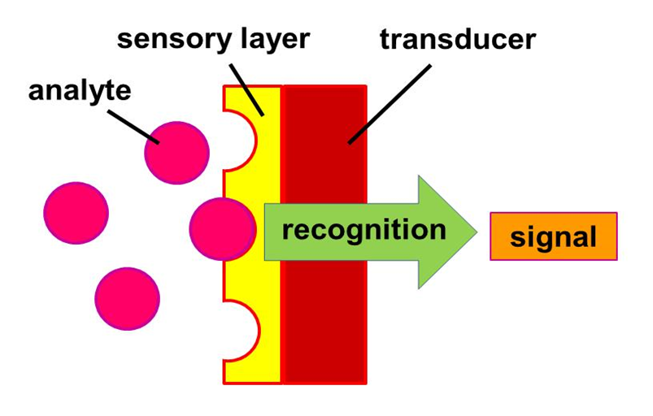
Biosensor
A biosensor is an analytical device, used for the detection of an analyte, that combines a biological component with a physicochemical detector.
A biosensor is an analytical device containing an immobilized biological material (enzyme, antibody, nucleic acid, hormone, organelle or whole cell) which can specifically interact with an analyte and produce physical, chemical or electrical signals that can be measured.
An analyte is a compound (e.g. glucose, urea, drug, pesticide) whose concentration has to be measured.
For instance, glucose is an 'analyte' in a biosensor designed to detect glucose.

Slide 7
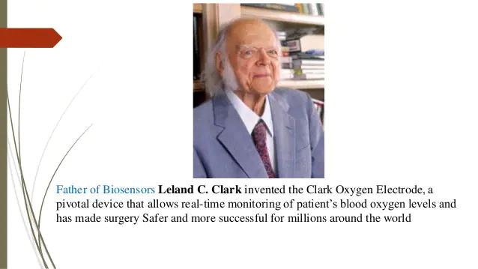
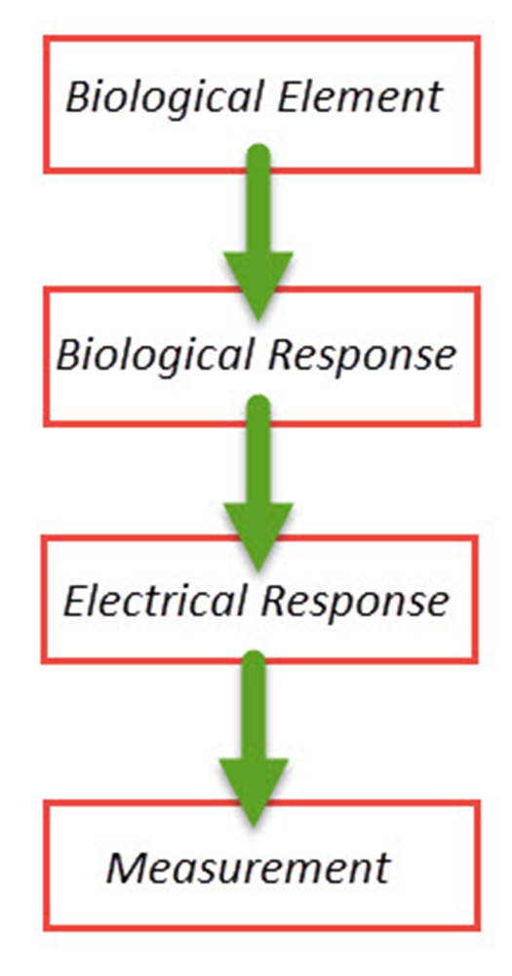
Biosensor
It is an analytical device which converts a biological response into an electrical signal.
It detects, records, and transmits information regarding a physiological change or process.
It determines the presence and concentration of a specific substance in any test solution.

Slide 8
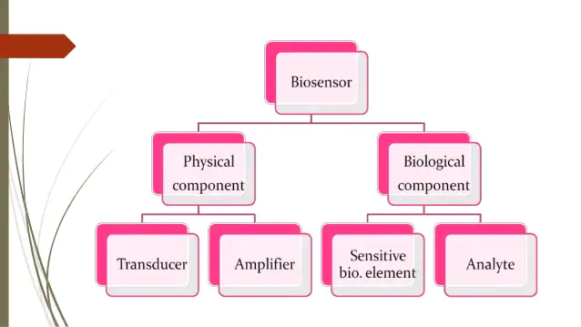
GENERAL FEATURES OF BIOSENSOR
Biosensors are devices comprising a biological element and a physiochemical detector that are used to detect analytes.
A biosensor has two components
Biological component: Enzyme, cell etc.
Physical component: Transducer, amplifier etc.
Biological component (Enzyme, cell etc.) recognizes and interacts with the analyte to produce a physical change (a signal) that can be detected, by the transducer.

Slide 9
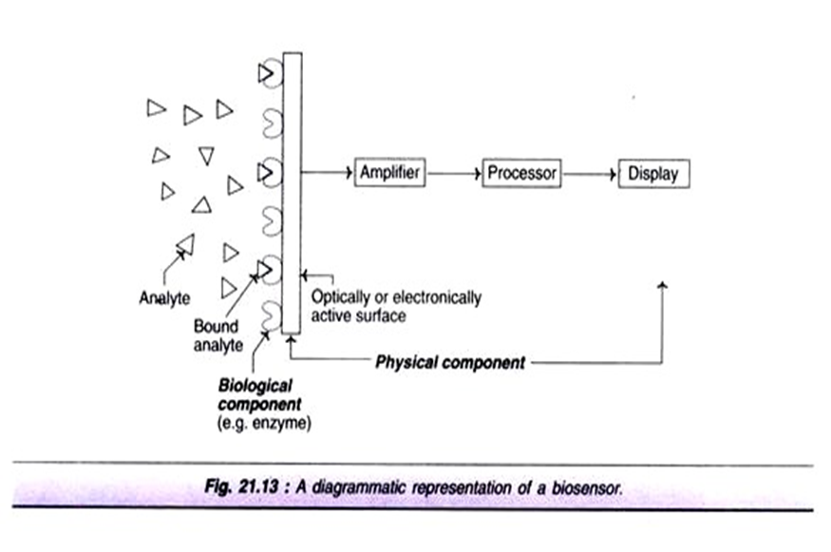

Slide 10
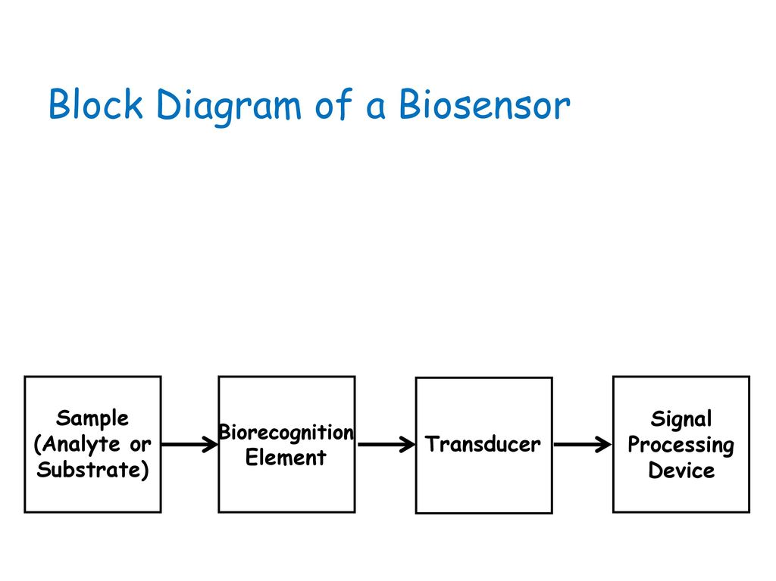
Basic Principle of Biosensor
Basic principle of biosensor involved in three element :
Biological recognition element which highly specific towards the biological material analytes produces.
Transducers detect and transduces signal from biological target - receptor molecule to electrical signal which is due to reaction occur.
After transduction, signal from biological to electrical signal where its amplification is necessary and takes place and read out in detector after processing the values are displayed for monitor and controlling the system.

Slide 11
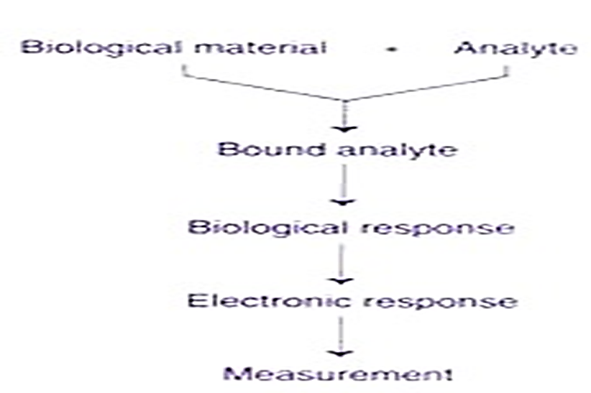
Working Principle of Biosensor
The biological material is immobilized and a contact is made between the immobilized biological material and the transducer
The analyte binds to the biological material to form a bound analyte which in turn produces the biological response that can be measured.
Sometimes the analyte is converted to a product which could be associated with the release of heat, gas (oxygen), electrons or hydrogen ions.
The transducer measures this interaction and outputs a signal.
The intensity of the signal output is proportional to the concentration of the analyte.
The transducer then converts the product linked changes into electrical signals which can be amplified and measured by the electronic system.

Slide 12
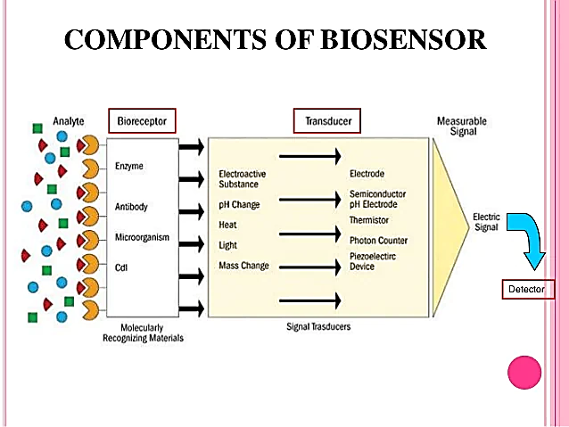

Slide 13
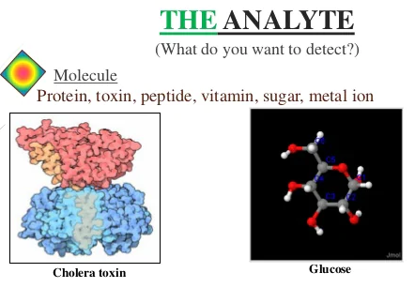
The Analyte
A substance of interest that needs detection
Chemical substance
Biological constituent
Glucose
Ammonia
Alcohol
Lactose
Metal ion
Protein
Toxin
Peptide
Vitamin
Antibody

Slide 14
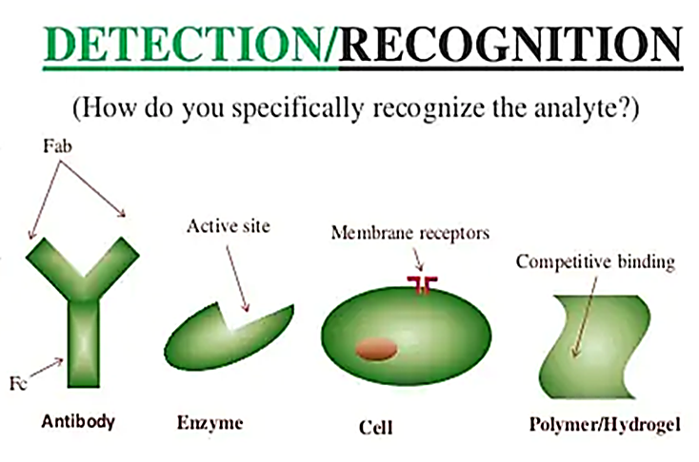
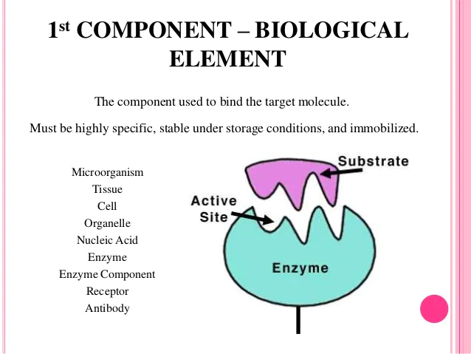
Bioreceptor
(Biological Element)
The component used to bind the target molecule
Microorganism
Must be highly specific, stable under storage conditions, and immobilized
Tissue
Cell
Organelle
Nucleic acid
Enzyme
Enzyme component
Receptor
Antibody

Slide 15
Types of biosensors
Based on Transducer
Ion-sensitive biosensor
Calorimetric/Thermometric Biosensor
Electrochemical Biosensor
Amperometric Biosensors
Potentiometric Biosensors
Impedimetric Biosensors
4. Wearable Biosensors

Slide 16
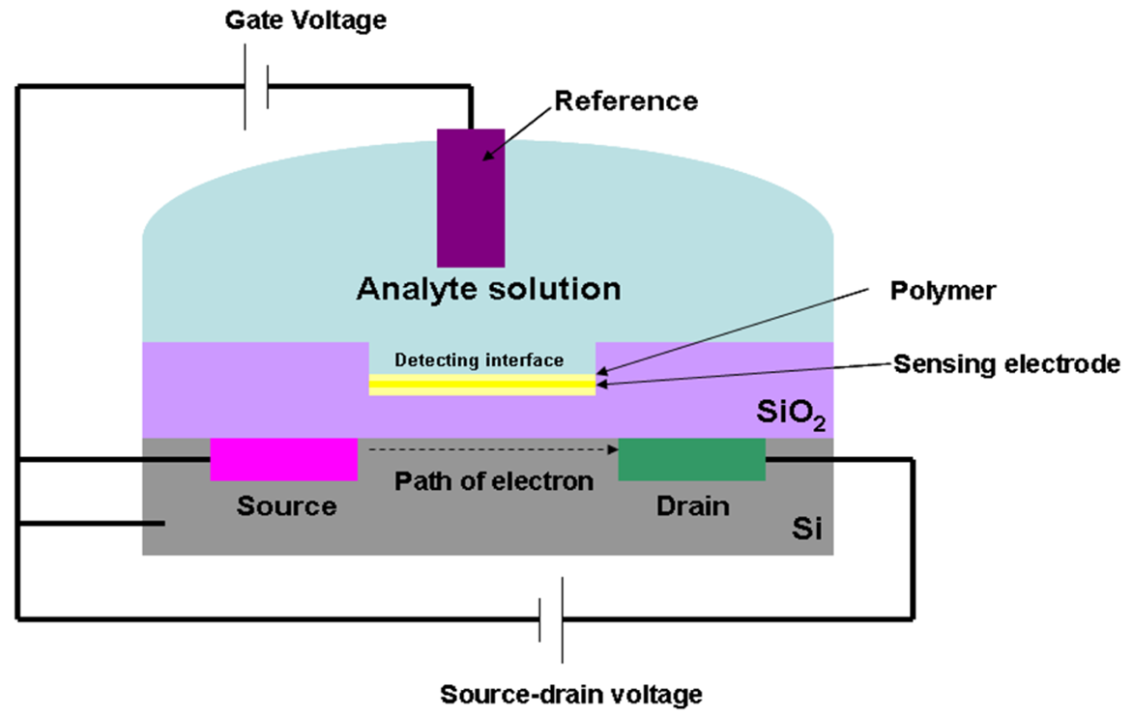
Ion Sensitive Biosensor
These are semiconductor FETs having an ion-sensitive surface.
The surface electrical potential changes when the ions and semiconductors interact.
This change in the potential can be subsequently measured.
The Ion Sensitive Field Effect Transistor (ISFET) can be constructed by covering the sensor electrode with a polymer layer.
This polymer layer is selectively permeable to analyte ions.
The ions diffuse through the polymer layer and in return cause a change in the FET surface potential.
This type of biosensor is also called an ENFET (Enzyme Field Effect Transistor) and is primarily used for pH detection.
Notes:
The field-effect transistor is a type of transistor that uses an electric field to control the flow of current in a semiconductor.
FETs are devices with three terminals: source, gate, and drain.

Slide 17
Calorimetric/Thermometric Biosensor
The output transduced signal that is measured as absorption or production of heat.
Temperature is measured by Thermistors.
If the enzyme catalyzed rection is exothermic, two thermistors may be used to measure the difference in resistance between reactant and product and hence the analyte concentration.
Advantages:
No need of frequent recalibration
Insensitive to the optical and electrochemical properties of the sample.
Uses:
Detection of : Pesticides and Pathogenic bacteria
The reaction takes place in a small enzyme packed bed reactor.
As the substrate enters the bed, it gets converted to a product and heat is generated.
e.g: When cholesterol gets oxidized by the enzyme cholesterol oxidase, heat is generated which can be measured.

Slide 18
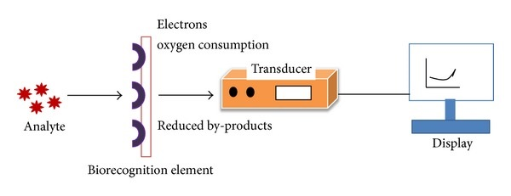
Electrochemical Biosensor
Many chemical reactions produce or consume ions or causing some change in the electrical properties of the solution that can be sensed out & used as a measuring parameter.
Such types of rection are called Redox reactions
Electrochemical biosensors are classified into three types:
Amperometric Biosensors
Potentiometric Biosensors
Impedimetric Biosensors
Generally, the electrochemical biosensor is based on the reaction of enzymatic catalysis that consumes or generates electrons.

Slide 19
Amperometric Biosensor
Amperometric for applied current: Movement of e⁻ in redox reactions detected when a potential is applied between two electrodes.
Generally, these Biosensors have reaction times, energetic ranges & sensitivities comparable to the Potentiometric-biosensors.
The simple amperometric biosensor infrequent usage includes the “Clark oxygen electrode”.
These biosensors are based on the movement of electrons (i.e. determination of electric current) as a result of enzyme-catalysed redox reactions.
Normally, a constant voltage passes between the electrodes which can be determined.
In other words, Amperometric biosensors measure the electric current associated with electron flow resulting from redox reactions

Slide 20
Potentiometric Biosensor
Potentiometric for voltage: Change in distribution of charge is detected using ion-selective electrodes.
They comprise two electrodes that are enormously responsive and strong.
This type of biosensor provides a logarithmic reply by means of a high energetic range.
For example pH meters.
These changes might be credited to ionic force, hydration, pH, and redox responses, the latter as the label of enzyme rotating above a substrate.
Potentiometric biosensors use ion selective electrodes to determine changes in the concentration of chosen ions.

Slide 21
Impedimetric Biosensor
This type of biosensors is measures the conductance of Impedance.
The EIS (Electrochemical impedance spectroscopy) is a responsive indicator for a broad range of physical as well as chemical properties.
The techniques of Impedimetric have been executed to differentiate the invention of the biosensors as well as to examine the catalyzed responses of enzymes lectins, nucleic acids, receptors, whole cells, and antibodies.
A rising trend towards the expansion of Impedimetric biosensors is being presently observed.

Slide 22
Wearable Biosensors
The wearable biosensor is a digital device, used to wear on the human body in different wearable systems like smart watches, smart shirts, tattoos which allows the levels of blood glucose, Blood Pressure, the rate of heartbeat,
For the human beings, these sensors may assist in premature recognition of health actions and prevention of hospitalization.
The possibility of these sensors to reduce hospital stays and readmissions will definitely attract positive awareness in the upcoming future.

Slide 23
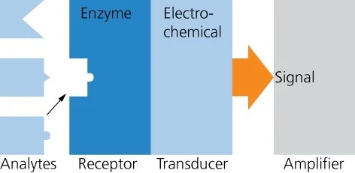
Enzyme Biosensors
An enzyme biosensor is an analytical device that combines an enzyme with a transducer to produce a signal proportional to target analyte concentration.
Because of their specificity and catalytic (amplification) properties, enzymes have found widespread use as sensing elements in biosensors.
An enzymatic biosensor comprises of an enzyme, which recognizes and then reacts with the target analyte producing a chemical signal, a transducer, which produces a physical signal out of that chemical one, and an electronic amplifier, which conditions and then amplifies the signal.

Slide 24
Glucose Sensors
Glucose sensors are biosensors designed to detect glucose levels, which is vital to managing diabetes. It is a good example of amperometric biosensors.
Whether in the form of a test strip for a blood glucose meter or a sensor for a continuous glucose monitor, the detection and measurement of glucose levels are similar processes.
For a glucose biosensor, the following components are used:
Analyte: glucose is the analyte that the biosensor is designed to detect.
Bioreceptor: The test strip for a blood glucose test contains the enzyme that interacts with the analyte in the drop of blood.

Slide 25
Glucose Sensors
Transducer: Most modern-day glucose meters and continuous glucose monitors measure electrical signals, although earlier generations of glucose meters used a colorimetric process (color change) that was measured optically.
Electronics and display: The processed signals are then quantified and shown on either the glucose meter’s display or the receiver for a continuous glucose monitor (or compatible app).

Slide 26
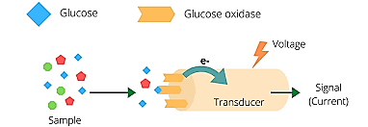
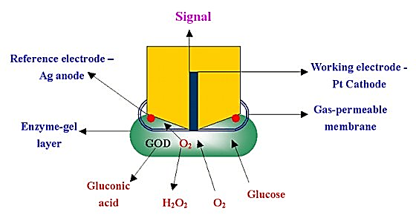
Home blood glucose detection sensor works on the principle of electrochemical.
Glucose mediator reacts with surrounding oxygen to form H₂O₂ and glucose oxidase.
Now this glucose oxidase react with more glucose.
Higher the glucose content, the higher the oxygen consumption.
Glucose content can be detected by Pt-electrode.
Two electrons and two protons are also produced.
Glucose reacts with glucose oxidase to form gluconic acid.
The biosensor in this instrument relies upon enzymes that recognize and catalyze reactions of glucose with the generation of redox – active species that are detected electrochemically.

Slide 27
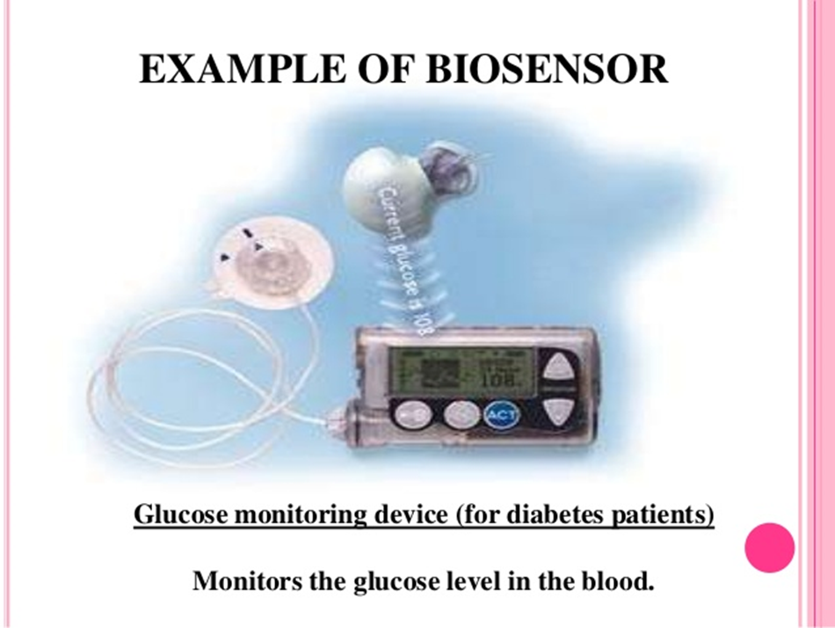

Slide 28
Immunosensors
Immunosensors are affinity ligand-based biosensing devices that involve the coupling of immunochemical reactions to appropriate transducers.
Immuno-biosensors or immunochemical bio­sensors work on the principle of immunological specificity, coupled with measurement (mostly) based on amperometric or potentiometric bio­sensors.
Immunosensors use antibodies as the recognition element and a transducer that converts the antibody–antigen binding event to a measurable physical signal.
Depending on the type of transducer there are four types of immunosensor: electrochemical, optical, microgravimetric and thermometric.
The most commonly used bio-elements for the development of electrochemical immunosensors are antibodies (Ab), followed by aptamers (Apt) and, microRNA (miRNA).

Slide 29
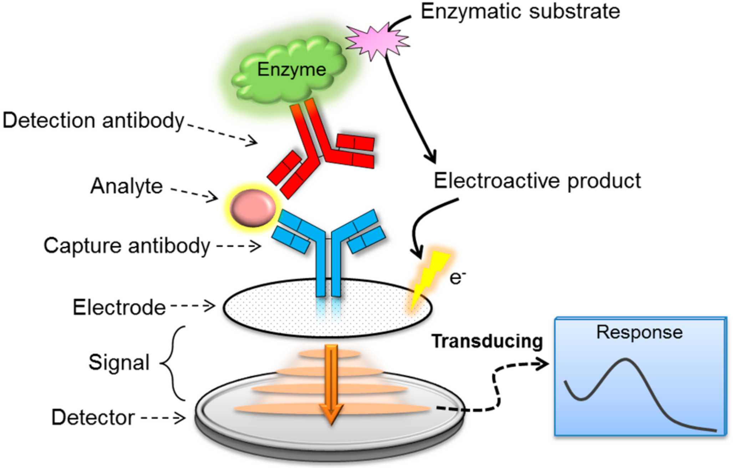
Analyte:
Antigen
Bioreceptor:
Antibody
Antigen is a substrate that stimulates the immune system to produce antibodies.
Antibodies are Y- shaped proteins formed in response to any foreign substance known as an antigen
Transducer:
Mostly amperometric or potentiometric bio­sensors
Electrochemical, optical, microgravimetric and thermometric
Electronics and display:
Sometimes aptamers (Apt) and, microRNA (miRNA) can be used.
The processed signals are then quantified and shown on display

Slide 30

Applications of Biosensors
Biosensor devices include a biological element as well as a physiochemical detector and the main function of this device is to detect analytes.
So, the applications of biosensors are in a wide range.
These devices are applicable in the medical, food industry, the marine sector as they offer good sensitivity & stability as compared with the usual techniques.
In recent years, these sensors have become very popular, and they are applicable in different fields.

Slide 31
Applications of Biosensors
Some examples of the fields that use biosensor technology include:
General healthcare monitoring
Medical Diagnosis
Metabolites Measurement
Screening for disease
Clinical analysis and diagnosis of disease
Drug development and improvement
Veterinary and agricultural applications
Industrial processing and monitoring
Environmental pollution control
Study & Interaction of Biomolecules
Detection of Crime
Quality Control

Slide 32
Common Applications of Biosensors
Biosensors are used in the food industry to measure carbohydrates, alcohols and acids, for example, during quality control processes.
The devices may also be used to check fermentation during the production of beer, yoghurt and soft drinks.
Another important application is their use in detecting pathogens in fresh meat, poultry or fish.
Biosensors are used to check the quality of air and water.
The devices can be used to pick up traces of organophosphates from pesticides or to check the toxicity levels of wastewater

Slide 33
Conclusion
These instruments have a wide range of applications ranging from clinical through to environmental and agricultural. The devices are also used in the food industry.
Biosensors can provide cost-effective, easy-to-use, sensitive and highly accurate detection devices in a variety of research and commercial applications.
A biosensor is universally defined as “a self-contained analytical device that combines a biological component with a physicochemical device for the detection of an analyte of biological importance”.
It consists of a biological recognition element which is able to specifically interact with a target molecule and a transducer able to convert this interaction into a measurable signal.

Slide 34
REFERENCES
C.B.Powar, 2010.Cell Biology.5th Ed,Himalyan Publishing House.
Leshie Cromwell, Fred.J. Weibell and Erich.A.Pfeiffer. 2003. Biomedical instrumentation and measurements. 2nd edition, PHI.
John G. Webster 1998. Medical Instrumentation: Applications and Design, 3rd edition, Jon Wiley and Sons, New York.
Jeremy M. Berg, John L. Tymoczko and Lubert Stryer. 2006. “Biochemistry,” 6th Ed. W.H. Freeman and Co. Ltd.
Robert Weaver. 2012 “Molecular Biology,” 5th Edition, MCGraw-Hill.
Jon Cooper, , 2004. “Biosensors A Practical Approach” Bellwether Books.
Martin Alexander, 1994 “Biodegradation and Bioremediation,” Academic Press.

Slide 35
THANK YOU

